Slide 1

Collision avoidance simulator in autonomous driving PROJECT SOFTWARE-DEFINED COMMUNICATION SYSTEMS
Umberto Pirovano - Andrea Conese - Andrea Paternò - Hamze Ghorbani Koujani
V1 presentation

Slide 2

ACCOMPLISHED GOALS
Version 1
Wireless channel simulator establishment
Path logic development
Results’ analysis
System assessment based on KPIs
Channel setup
implementation of the python class
channel and modulation settings
introduction of real-world parameters
Path logic
Obstacle Detection
Decision Making
Real-Time Adaptation
Results’ analysis and system assessment
Improve the ROI
Performance optimization to reduce the RTT
Average Tx time vs distance
Tuning of simulation and decision-making parameters

Slide 3
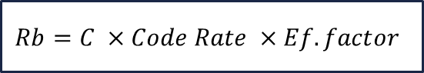
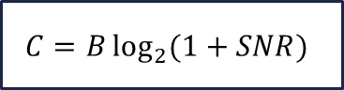
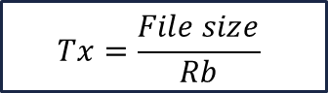
WI-FI 6 ABSTRACT
$$C=B\log_{2}{(1+SNR)}$$
SNR :
- Transmitted Power
- Noise Power
- Free Space Path Loss
- Shadowing
Code rate = 5/6
Efficiency Factor: random factor that takes into account further losses
$$Rb=C ×Code Rate ×Ef.factor$$
$$Tx=\frac{File size}{Rb}$$

Slide 4
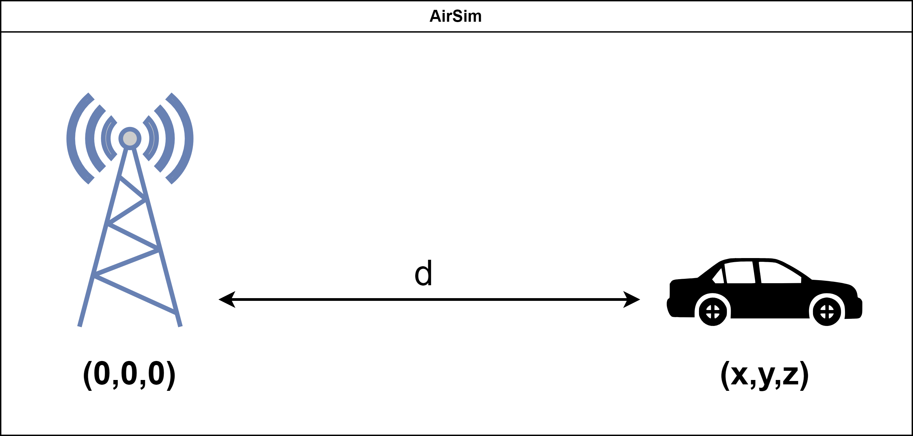
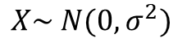
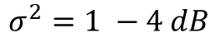
FSPL and Shadowing
$FSPL=10\log_{2}{(d)}+$ $10\log_{2}\left(f\right)+32,4$
$$X\sim N(0,σ^{2})$$
f : central frequency (2.4 / 5 [GHz])
d : distance [m]
$$σ^{2}=1 −4 dB$$
Hypothetic antenna defined exploiting AirSim’s coordinate system

Slide 5
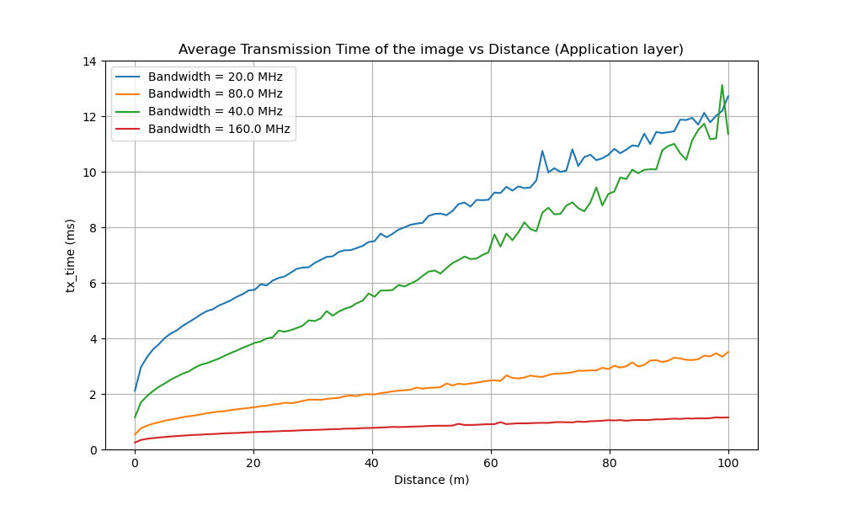
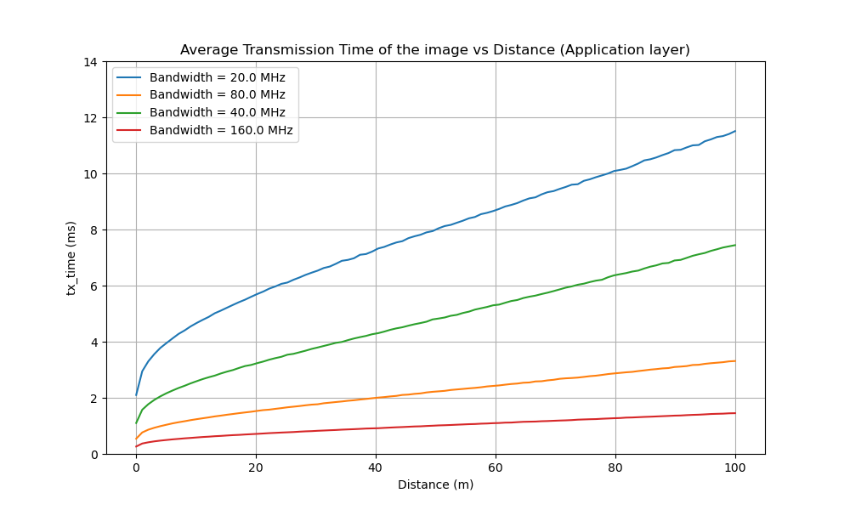
Transmission time vs Distance
With shadowing component
Shadowing component neglected

Slide 6
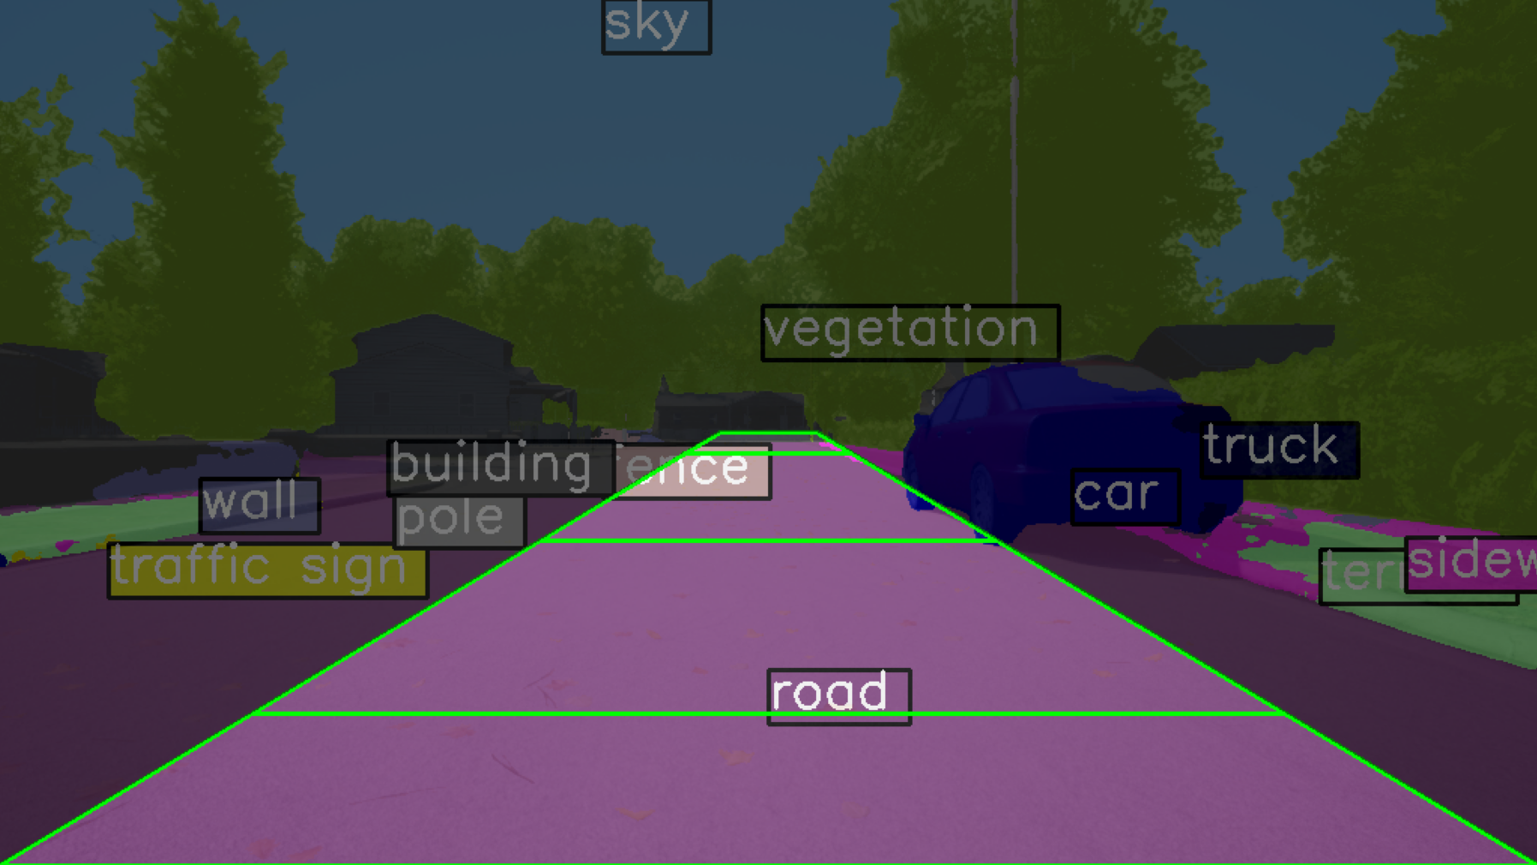
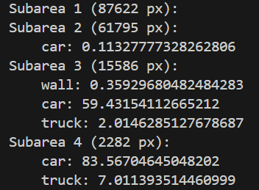
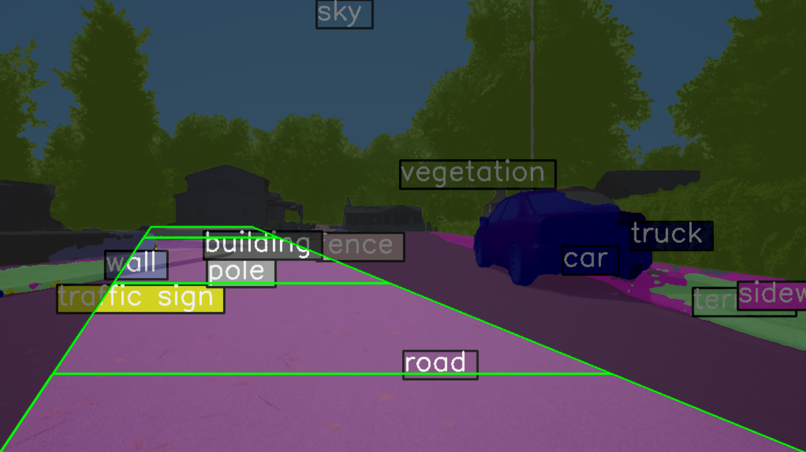
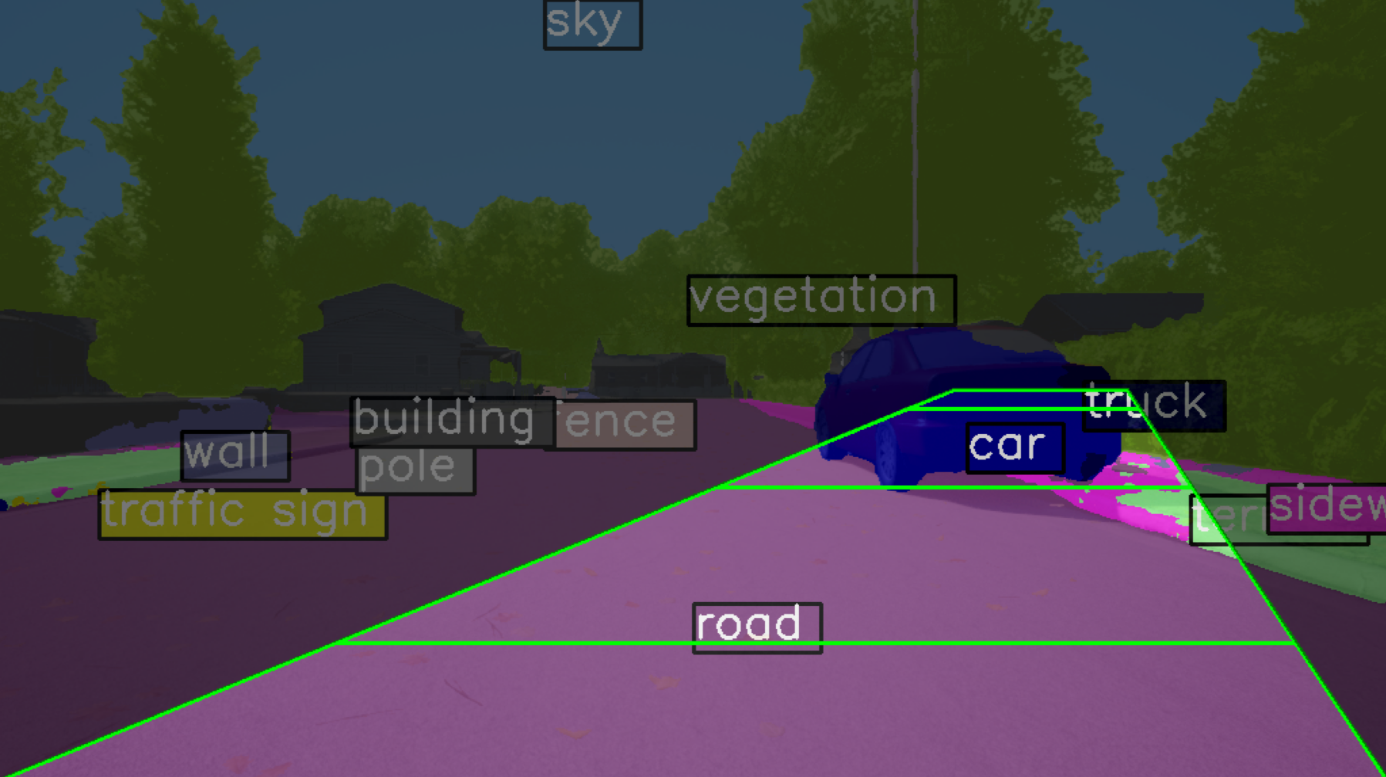
PATH LOGIC
THE REGION OF INTEREST (ROI)
Different sub-regions
Handles turning
Tells you what is inside each sub-region (and the relative occupied area!)
Blacklist of labels
Path logic algorithm

Slide 7
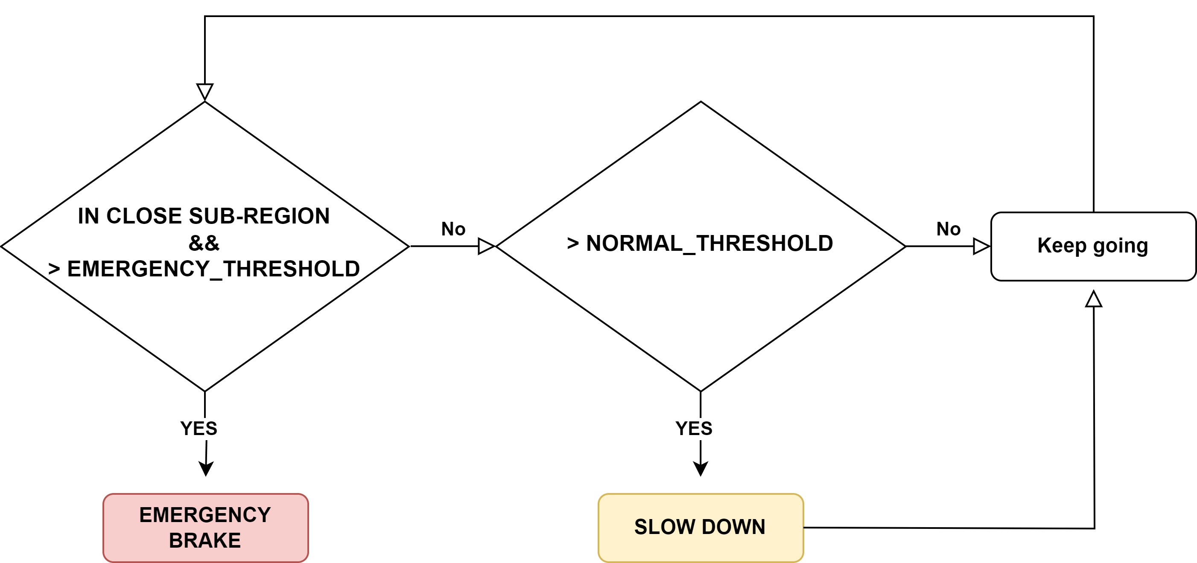
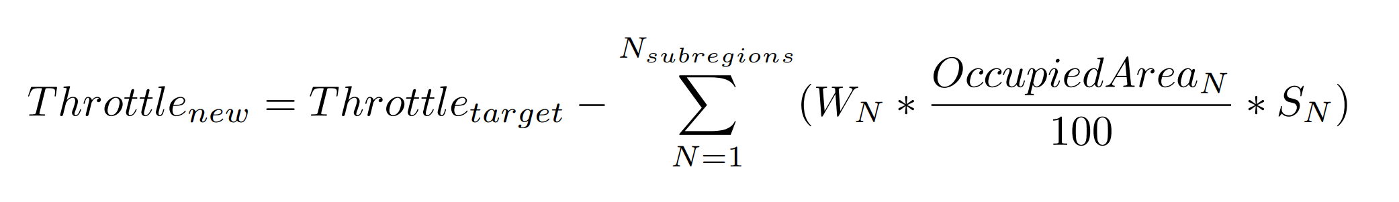
PATH LOGIC
PATH LOGIC ALGORITHM
Different weight for each sub-region
Sensibility factor determined by the smallest object in the sub-region
The effectivness depends on how frequently images are segmented and feeded to the algorithm

Slide 8
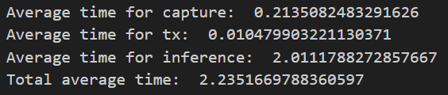


PERFORMANCE ANALYSIS
* Times in seconds (s)
Capturing the images (PNG) from AirSim takes around 200ms
Tx time to upload the image is very low!
Performing segmentation on one single image can take up to 2000 ms ( LIMITED BY THE HARDWARE! )

Slide 9
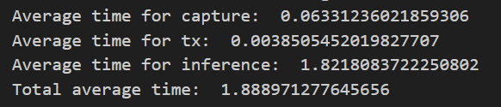




PERFORMANCE ANALYSIS
* Times in seconds (s)
PNG - no compression - size: 1000 KB
JPEG - quality: 80% - size: 100 KB
Using JPEG compression we have significant improvements!

Slide 10

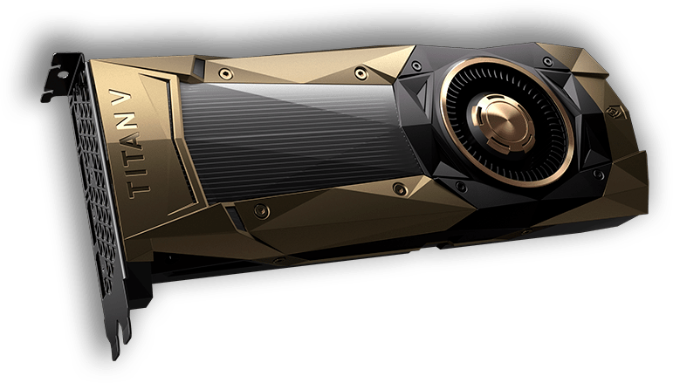


PERFORMANCE ANALYSIS
4 different CV models are integrated in the system
TAG | MEMORY REQUIRED (GB) | INF. TIME (FPS) NVIDIA RTX 2060 | INF. TIME (FPS) NVIDIA v100 *
super_light | 2.2 | 0.8 | 14.27
light | 6.35 | 0.65 | 7.87
medium | 7.5 | 0.55 | 3.94
heavy | 12.5 | 0.5 | 1.15
*SOURCE: mmsegmentation/configs/deeplabv3plus at main · open-mmlab/mmsegmentation (github.com)

Slide 11
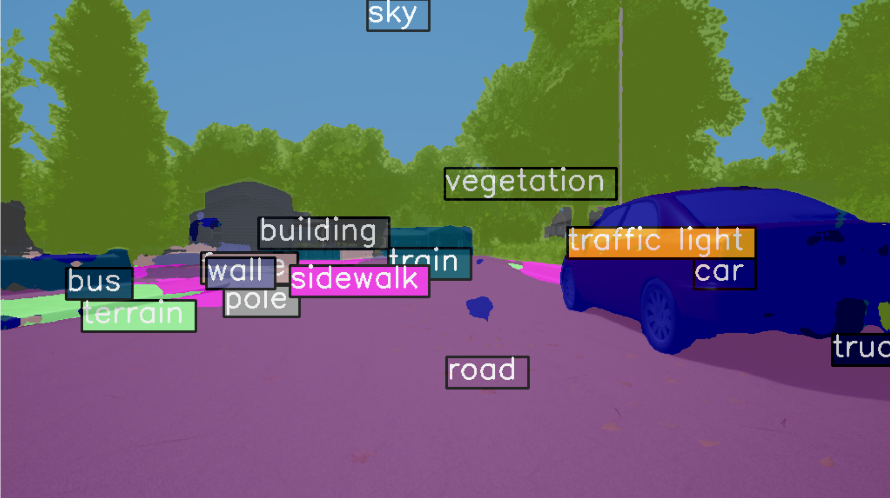
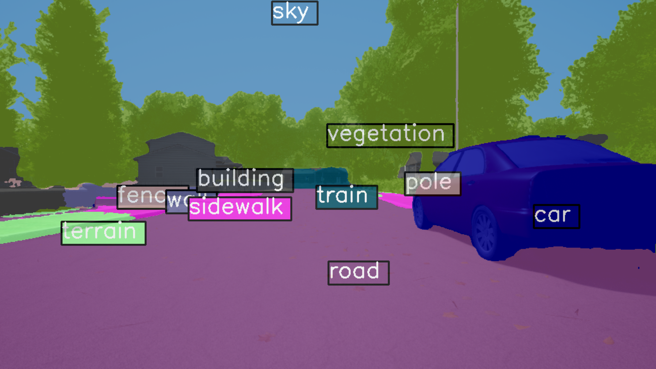
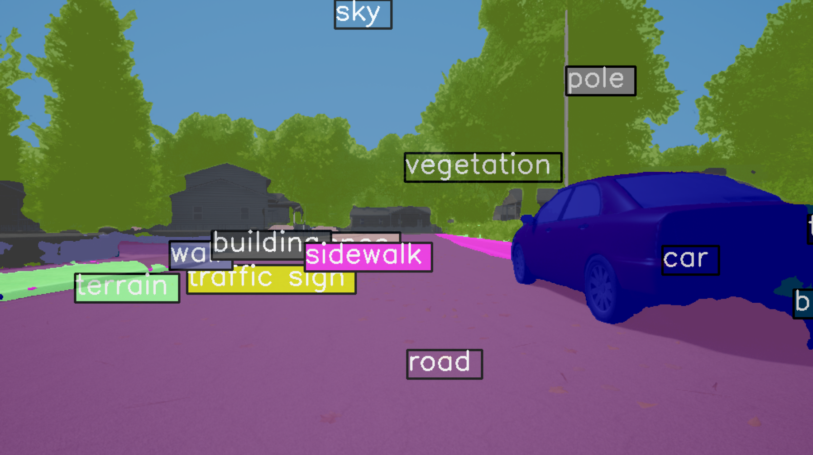
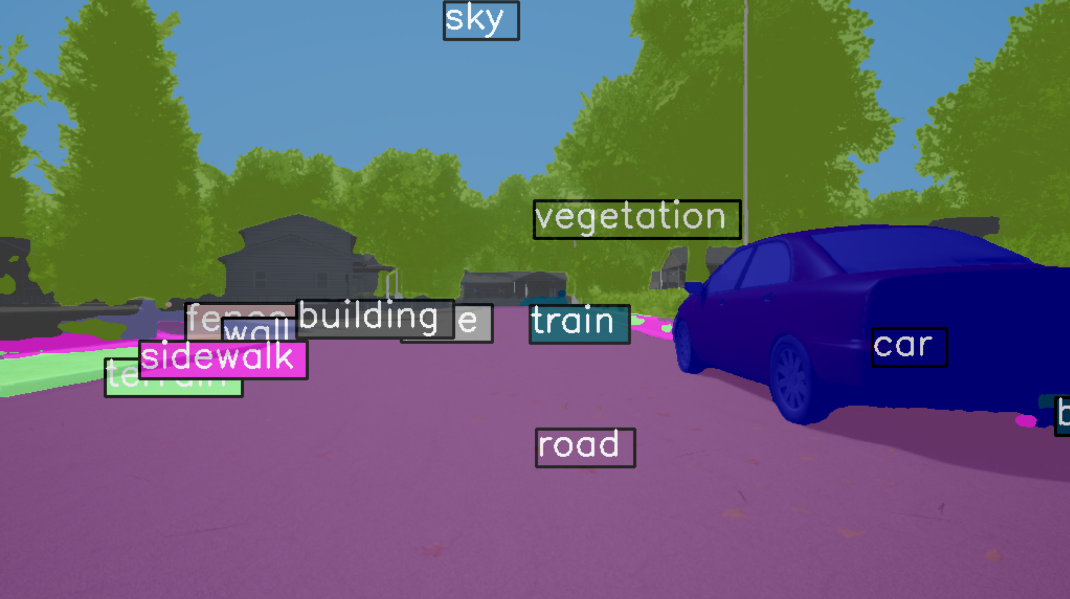
PERFORMANCE ANALYSIS
Super-light
light
medium
heavy

Slide 12
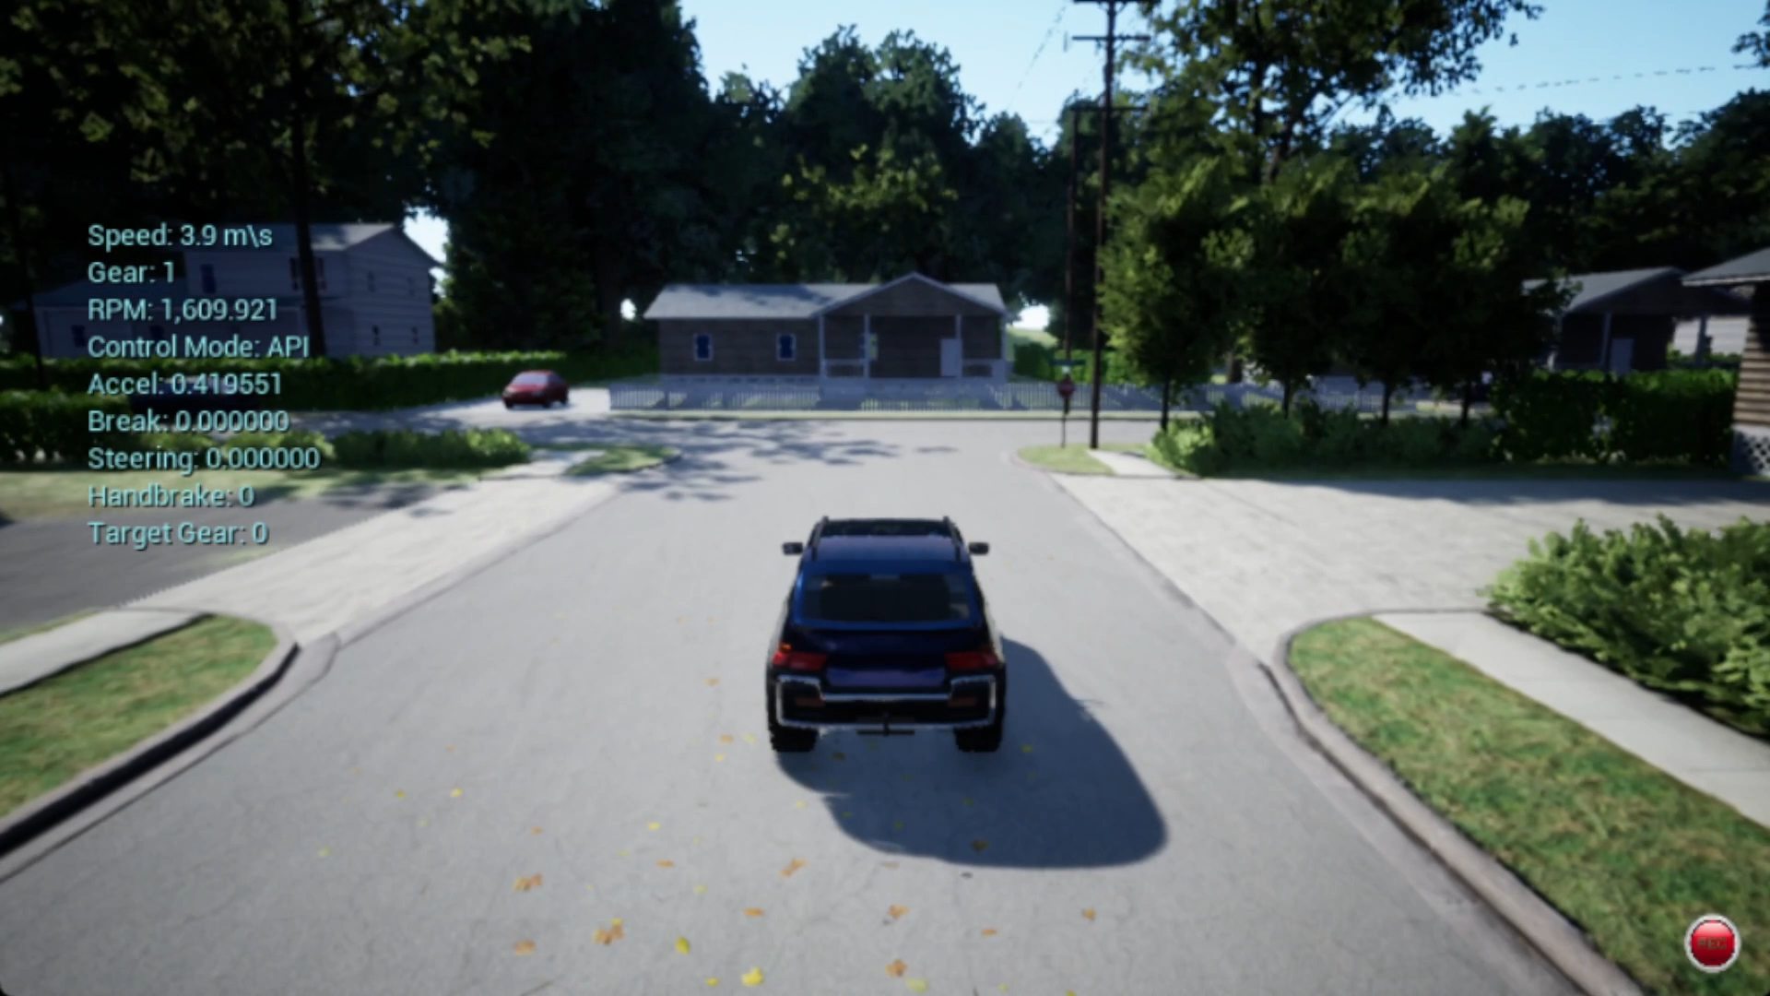
DEMO
Obstacle: fence

Slide 13
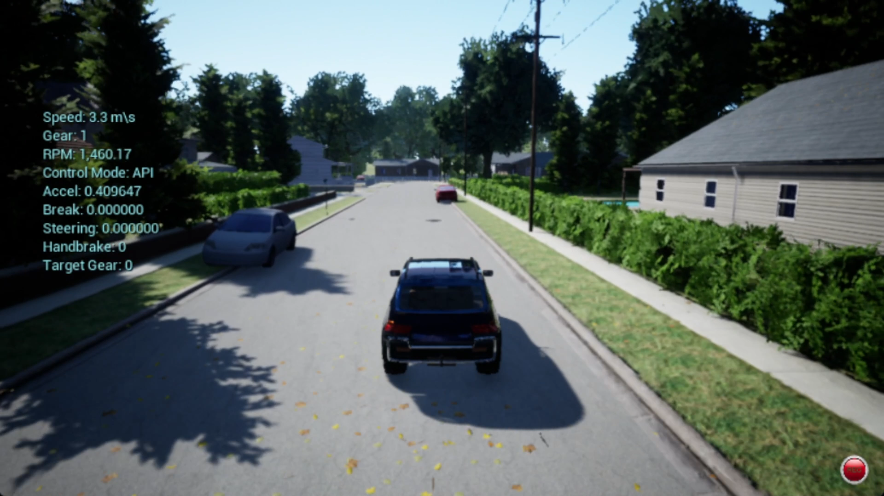
DEMO
Obstacle: car

Slide 14
CONCLUSIONS
CHALLENGES
Implement the wifi channel
How to estimate the distance without using sensors?
Implement the Path logic
Putting everything together
Tuning the system and make it work
SOLUTIONS
Research
ROI and subdivision into sub-areas
Teamwork! Mix of multiple ideas
Exploiting python and Object-oriented programming
A lot of patience

Slide 15
Gantt Chart
TODAY
Initiative | Objective | April 1 | April 2 | April 3 | April 4 | May 1 | May 2 | May 3 | May 4 | June 1 | June 2 | June 3 | June 4
Version 0 | Simulate the urban scenario in AirSim and achieve video frames.
 | Prepare the data and feed it to the CV model and detecting objects.
 | Basic results’ analysis
Version 1 | Measure the distance from detected objects. Providing steering and speed change information.
 | Establish a IEEE 802.11ax channel simulator, transmitting images from airsim to CV model.
 | Refine the channel simulator to send steering data back to theAirsim. Integrate the whole project.
 | Results’ analysis and evaluation
Version 2 | Develop GUI for the final project. Prepare detailed reports.

Slide 16
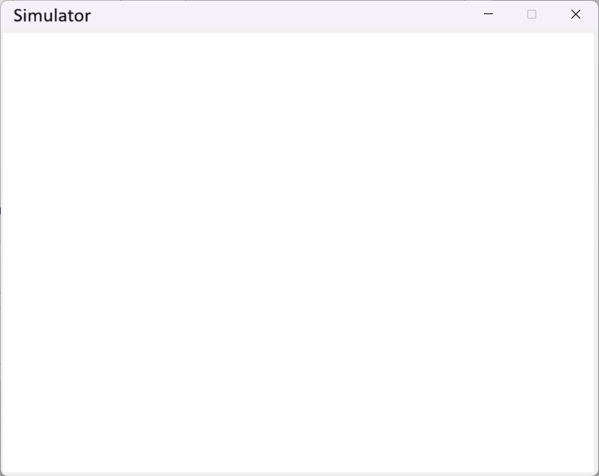
… NEXT STEPS
Version 2
Final refining of the simulator
GUI implementation
Set Simulator – AirSim connection
Set simulation parameters
Make the system easy to use

